Slide 1
Promoting Positive Behavior at school, Home, and in the Community
Bedminster Township School
School-Family Partnership Series
Elena Garcia-Albea, Ph.D., BCBA-D

Slide 2
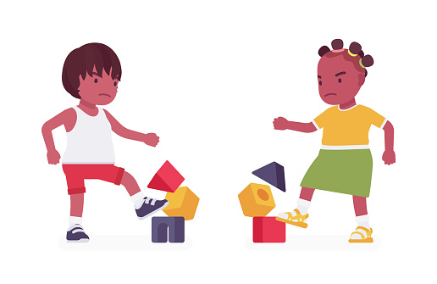
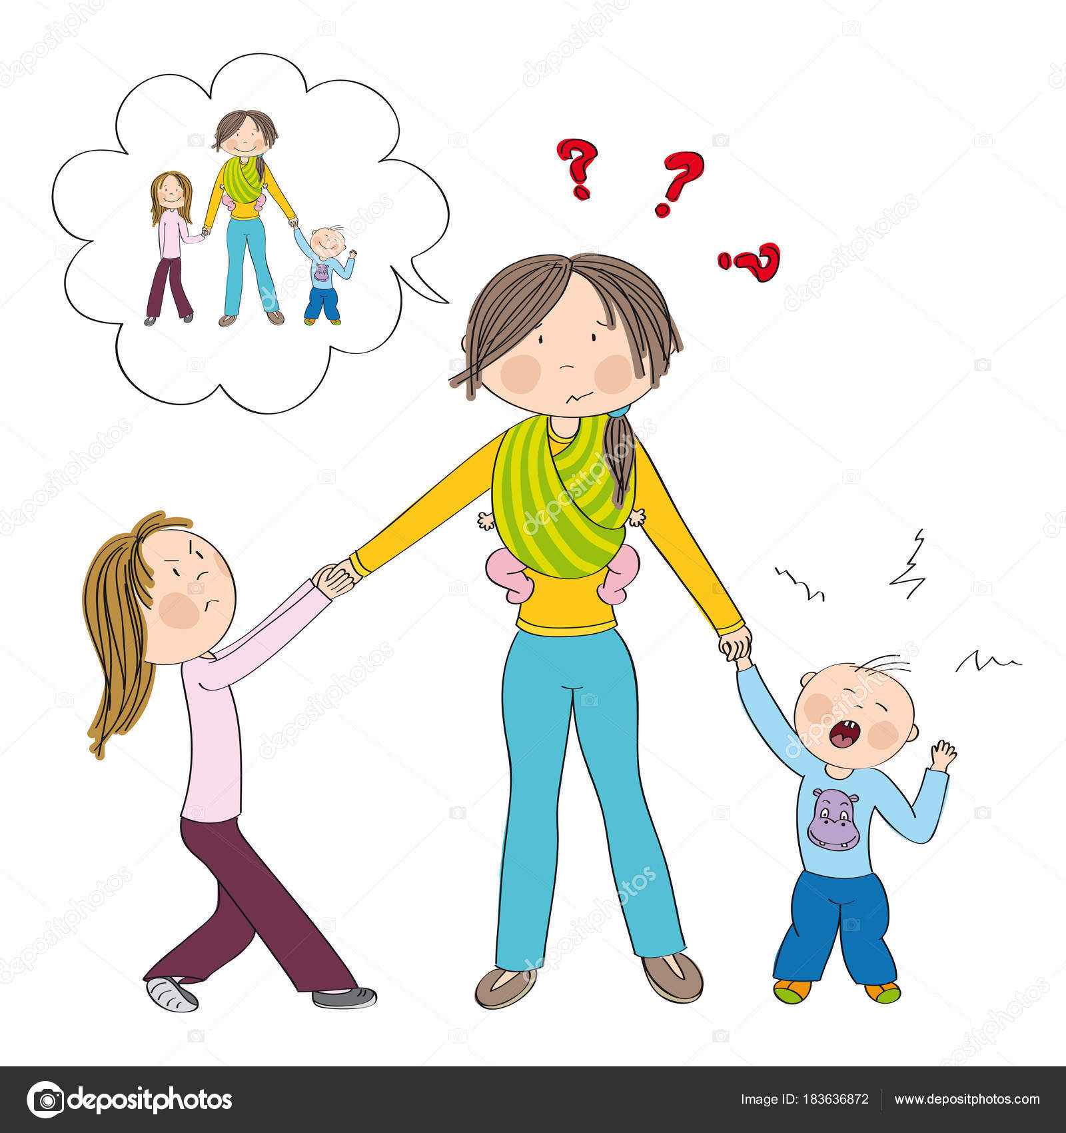
HELP!!!

Slide 3
What can we do?
Why is he / she doing that?
Teach and reinforce (positive) replacement behaviors
Identify ways to PREVENT behavior from occurring
Change the consequence after the problem behavior (reduce behavior)
1
2
3
4

Slide 4
1. Why is he/she doing that?
When/Where is the behavior happening?
Time of day
With a specific person
During certain tasks
What is happening after the behavior occurs?
All behavior happens for a reason…..
Attention
Escape/avoidance
Restricted access (Tangible)
Automatic Reinforcement (Sensory)

Slide 5
Behavioral Function
“I don’t want to do this!” (Escape) | ”I want attention!” (Attention) | ”I Want this!” (Tangible) | “I like doing this!” (Sensory)
Difficult tasks Prolonged Work Social Demands “I don’t want to be in this place” “I don’t want to be with this person!” | From parents From teachers From peers From siblings From anyone | A toy An object A food or treat An activity A privilege | It feels good It looks good It sounds good It tastes good It’s a habit
The Function of Wanting Power/Control
Generally not supported in the research literature.
What may seem like power and control may be attempts to access peer attention/access adult attention/escape a task

Slide 6
Behavior Change
Helping a child change their behavior is best done by the adults around the child changing what THEY are doing.
Set the environment up for success!
Blaming the child by labeling them “stubborn” or “defiant” → not useful or accurate
Unclear expectations
Inconsistent expectations
Teacher/parent has lack of resources
Areas for skill building

Slide 7
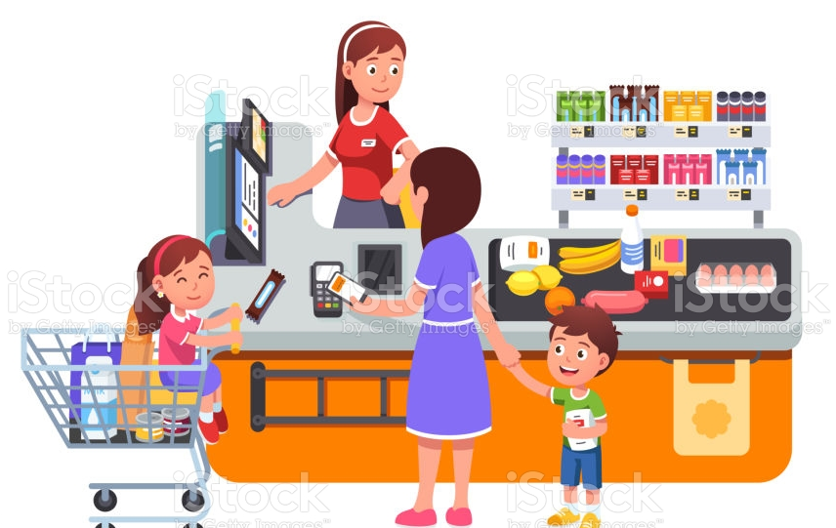
2. Teach and reinforce replacement behaviors
WHAT DOES THIS MEAN?
Alternative behaviors
Incompatible behaviors
WHAT DOES THIS LOOK LIKE?
What do you want your child to do instead???
Teach that response

Slide 8
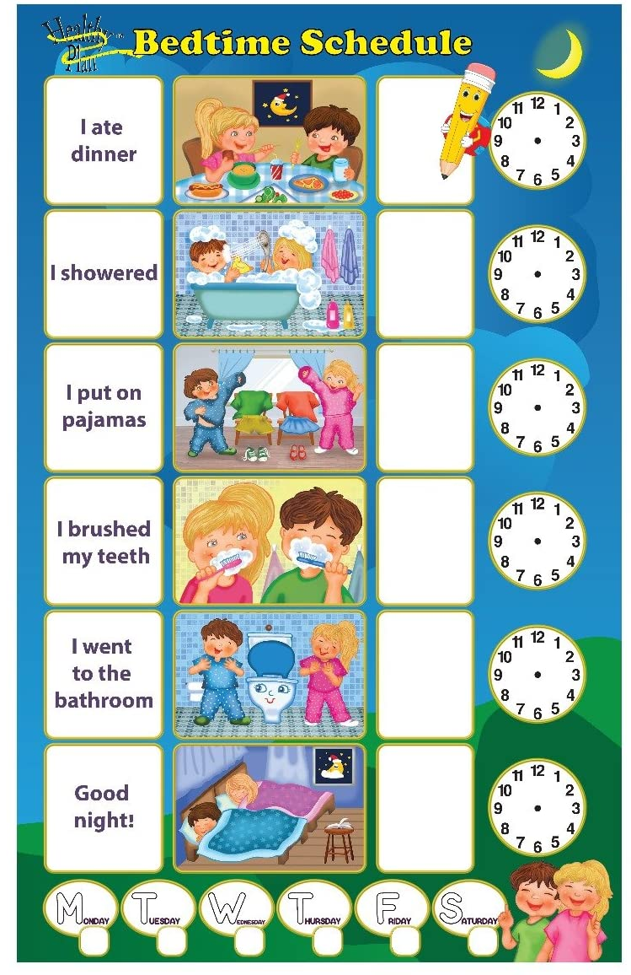
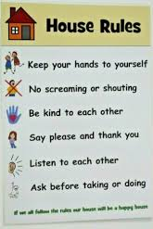
3. Identify ways to PREVENT behavior from occurring
Strategies that focus on structuring and modifying the environment and conditions that occur BEFORE an unwanted behavior so that the behavior is LESS likely to occur
PROACTIVE APPROACH
Examples:
Room set up
Reviewing rules
Transition warnings
Visual schedules
Reducing demands (reasonably)

Slide 9
Other Proactive Strategies…..
Break down complex tasks into smaller, individualized teaching units
Incorporate preferred materials or interests into tasks
Make it fun!
Provide choice when presenting a demand
Provide high levels of contingent praise/feedback

Slide 10
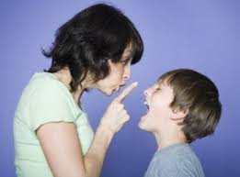
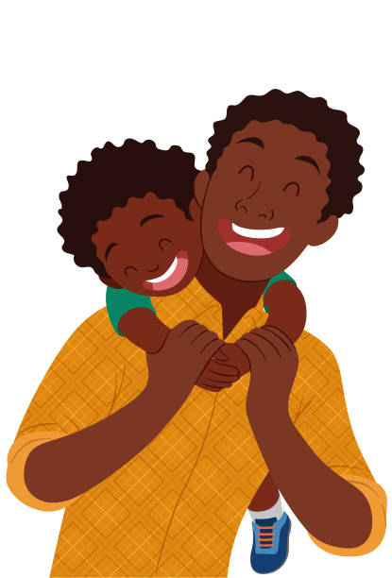
4. Change the consequence after the problem behavior
Strategies that focus on structuring and modifying the environment and conditions that occur AFTER behavior occurs
Used to minimize reinforcement for problem behavior and increase reinforcement for desirable behavior.
Everyday Examples:
Praise
Allowances
Certificates
Extra credit
Reprimand
Detention
Speeding ticket

Slide 11
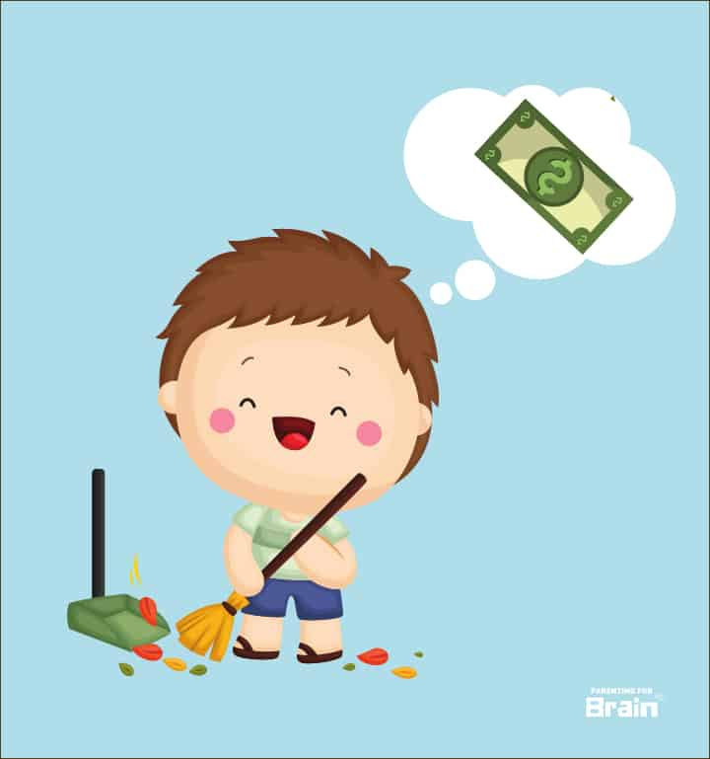
reinforce desired behaviors
Reinforcers are your behavior change tools. Identify and control them!
Reinforcement:
anything that increases a behavior
Can be getting preferred things (e.g., toys, attention, food)
Can be getting rid of bad things (e.g., demands, bedtime, shoes)
Reprimands and negative attention can sometimes be reinforcers
Reinforcement can increase desired and undesired behavior
Negative behavior often gets reinforced more often than positive behavior.
Different for each person and changes frequently
What may reinforce my behavior will not reinforce your behavior!
Set up lots of opportunities for good/correct behavior (Don’t just wait for them)

Slide 12
The Power of reinforcement
Reinforcement is the foundation of any behavior change program
Effectiveness relies heavily on the reinforcers you use
Can be used to teach a wide array of different behaviors
Teaches NEW behavior in a way that is positive and strengths-based
Spend most of your time rewarding your child for what they are doing right, rather than correcting the things that go wrong
Only give reinforcers when your child engages in the desired behavior
Any behavior you want to see more of should be reinforced!

Slide 13
Take-Away’s
All behavior happens for a reason
Anticipate your child’s needs before his/her undesired behavior forces you to meet his needs
Avoid situations that you think might make the child irritable (or have a plan ready)
Staying out past their bedtime
Shopping for a long time
Reinforcement is the foundation of any effective behavior change program
Catch your child “being good”!!!
Teach others in the home what you have learned today (Consistency is crucial)
Be a good role model
Have lots of fun with your kids!

Slide 14
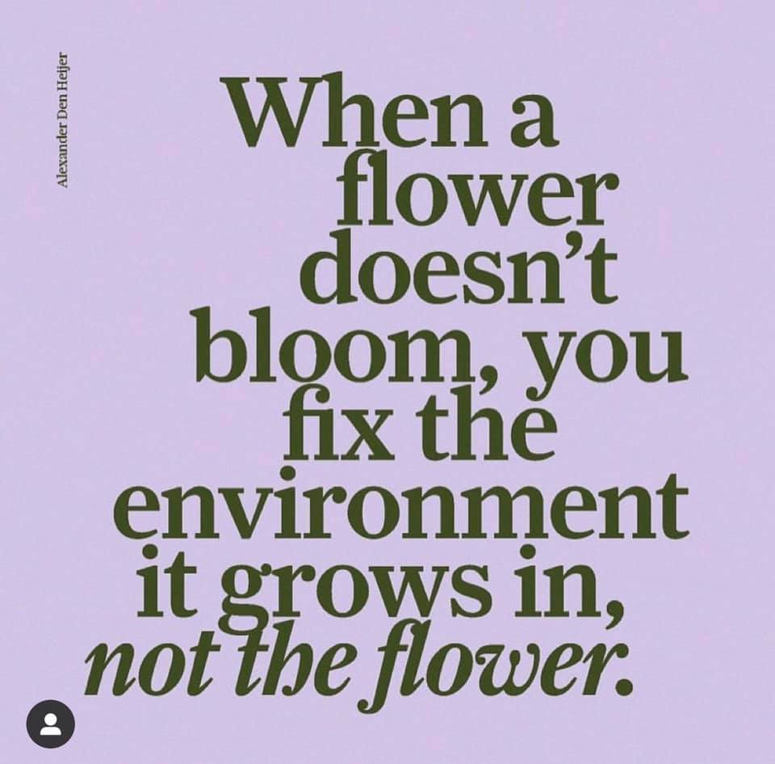
egarcia@bedminsterschool.org
(908) 234-0768 x100

